Slide 1
CI/CD Pipeline with Governance
Architecture, Flow, and Promotion Strategy

Slide 2
Overview
This Architecture demonstrates a secure and governed CI/CD setup for a containerized application (helloworld) using GitHub Actions, Docker, and Helm. It integrates image scanning, promotion workflows, and policy-driven deployment decisions across different branches.
Goals
Build -> Scan ->Validate -> Deploy securely
Enforce promotion from lower to higher environment
Auto block on critical CVEs.
Track scan results and governance.
Ready for GitOps Integration.
Repository Structure
• release/dev: CI build, scan, push Docker image
• release/uat: Validate scan and deploy to UAT
• main: Production-ready branch
• ci-config: Shared governance logic and templates
• release/dev: CI build, scan, push Docker image
• release/uat: Validate scan and deploy to UAT
• main: Production-ready branch
• ci-config: Shared governance logic and templates

Slide 3
Tool Selection Justification
GitHub (Repo, Actions, Branching Strategy) : Centralized source control and automation in one platform, no need to maintain a separate CI/CD tool. Allowed me to implement both CI and CD pipelines with governance using only repo-based workflows
Trivy (Image Scanning): Open-source, quick to integrate, covers OS packages and application dependencies for CVEs. Aligned with governance requirement — block promotion if CVEs found above a threshold
Helm: Standard Kubernetes package manager, lets us templatize deployments. Even without GKE/EKS, Helm allows a deployment structure that is cloud/K8s-ready.
Governance via Repo (Policies & Dispensation Files): Instead of a heavy policy engine, used GitHub repo itself for governance rules. Simple to audit, versioned, and enforced via pipelines.
Docker Desktop: Lightweight, local container runtime to simulate Kubernetes or production environments without cloud dependencies. . Immutable & Traceable: SHA256 digest is unique per image build — no accidental re-tagging (unlike latest).Prevents ambiguity; we always know exactly which image is deployed.

Slide 4
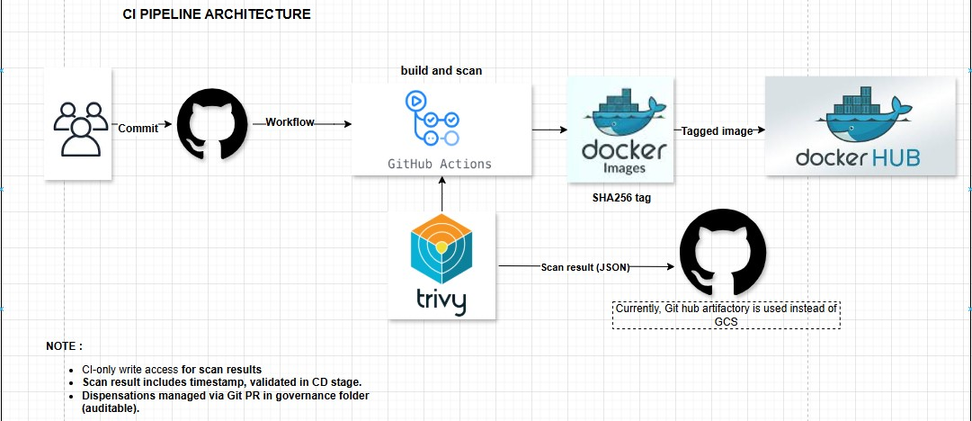
CI Pipeline - release/dev
CI FLOW
Triggered on push to release/dev
Builds Docker images from app/
Performs vulnerability scanning using Trivy
Stores scan results in Github Artifact with Json format with name scan-results-git.sha
Pushes validated images to Docker Hub
Folder Structure
.github/workflows/ci.yaml: CI pipeline logic
app/: Source code and Dockerfile
scan-results/: JSON reports of image scans
scripts/validate-scan.py: Used later in CD pipeline

Slide 5
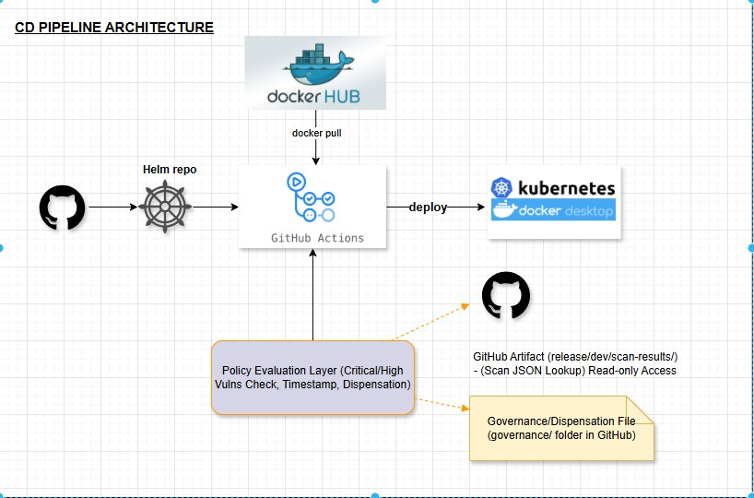
CD Pipeline - release/uat & main
CI Flow
Triggered on push to release/uat or main
Fetches scan result from github artifactory
Validates scan using validate-scan.py for security gating
Pulls approved Docker images from docker hub
Deploys using Helm or Docker
Folder Structure
.github/workflows/cd.yaml: CD pipeline logic
charts/: Helm chart for deployment
scripts/validate-scan.py: Scan validation script
scan-results/: Approved image scan results copied from Github Artifactory.

Slide 6
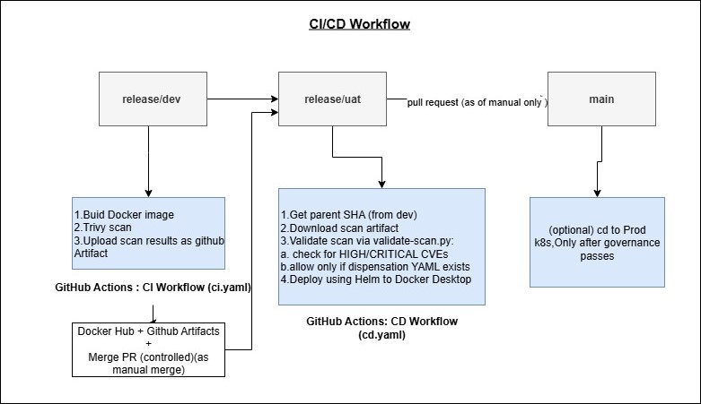
Promotion Flow
Changes move via PRs: dev → uat → main.
Scan results promoted along with image.
Branch protection can enforce quality.
Traceability from scan to deployment.
Release/dev has read only access to developer and feature branch is merged to release/dev after raising PR.

Slide 7
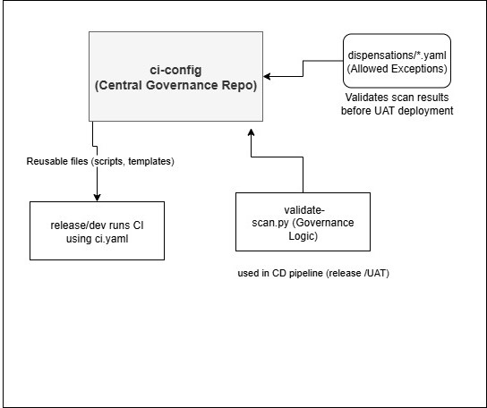
Governance Strategy
Validate-scan.py checks for CVEs
Blocks deploy if critical CVEs found
Dispensation files allow justified exceptions
Centralized in ci-config branch
Audit logs for dispensation overrides
Separation of duties between dev , security and Ops Team

Slide 8

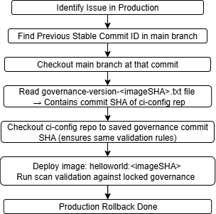



Identify the issue in production and decide the last known stable deployment commit in main.
Checkout that commit in main to get the exact application version.
Read the governance version file (governance-version-<imageSHA>.txt) from that commit to find the matching ci-config commit.
Checkout the ci-config repo at that specific commit to restore the exact security policies used earlier.
Deploy the same Docker image (helloworld:<imageSHA>) that was previously validated.
Rollback Strategy

Slide 9
Create a hotfix branch from the current production (main) commit.
Apply only the required fix — keep changes minimal to reduce risk.
Run CI pipeline for that hotfix by creating a PR from hotfix branch -> release/dev to rebuild the image and generate scan results.
Ensure governance validation passes using the latest approved rules from ci-config.
Merge the hotfix branch into main and deploy immediately to production.
Emergency fixes

Slide 10
Preventing Tampering with Scan Results
Branch protection rules:
Only release/dev can generate and commit scan results.
Direct pushes to release/dev, release/uat, and main are blocked — PR or cherry-pick only.
Governance enforcement:
ci-config/governance/ contains rules that validate scan results in CD before deployment.
validate-scan.py checks that:
The file exists in the repo.
The SHA in the scan file matches the image being deployed.
Audit trail:
Scan results are stored as committed JSON in GitHub, so every change is version-controlled and traceable.

Slide 11
Handling Stale or Missing Scan Data
CD pipeline explicitly fetches scan results from Github artifact for which we have given limited access only to responsible teams.
If the scan result for that SHA is missing, the validation step fails immediately: This prevents deploying unscanned images.If the scan result is older than configured policy allows (added a date check in validate-scan.py), the deployment is blocked until a fresh scan is run in release/dev.
Handling Change Management During Incidents
Planned Changes: Go through standard PR → review → scan → promote flow.
Incident/Emergency Changes:
Incident ticket created in the tracking tool (JIRA/ServiceNow).
Hotfix branch created from the branch closest to Prod (release/uat or main).
CI pipeline runs on hotfix for security validation — even in emergencies.
Fast-track approval from backup approvers.
Immediate deployment to Prod if validated.
Post-deployment RCA & governance review to capture lessons and adjust processes if needed

Slide 12
Shared Library Simulation • ci-config branch acts like internal shared library.
• Stores reusable workflows, validate-scan logic.
• Maintains consistency across environments. Helm & Image Management • Helm chart in charts/helloworld/ .
• values.yaml holds image and tag (SHA).
• Ensures consistent version deployment. Summary . CI/CD with security gates and governance.
DockerHub + GitHub = Full traceability.
Well-defined PR-based promotion strategy.
Ready for production with centralized validation.
Architecture is secure , auditable and standardized.Active and Passive monitoring can be implemented to make sure system is runing as expected after and during deployment by dynatrace integration.

